Slide 1


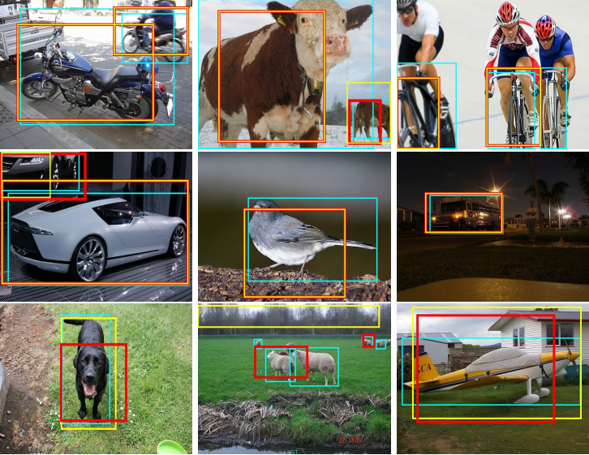
Designing Feature Descriptor for Image Classification

Slide 2
Presented By
Md. Mostafijur Rahman
MSSE0303
Institute of Information Technology
University of Dhaka
Supervised By
Dr. Mohammod Shoyaib
Associate Professor
Institute of Information Technology
University of Dhaka

Slide 3
Outline
Introduction and Motivation
Existing Works
Problem Specification
Proposed Solution
Experimental Evaluation
Conclusion and Future Work
Q & A

Slide 4
Introduction
Image classification: Given a set of images, the objective is to classify those by the
face,
expression (e.g., happy, sad),
gender (e.g., male, female),
scene (e.g. coast, forest, classroom, kitchen),
object categories (e.g. cars, leopards, laptop).

Slide 5
Scope
Face verification
Facial expression recognition
Gender classification
Scene classification
Texture classification
Object classification
Aerial image classification
Garments pattern classification
Flower classification
Leaf classification

Slide 6
Applications
Biometric authentication
Access control
Surveillance system
Market demand analysis
Photosynthesis
Medical imaging
Entertaining tools

Slide 7
General Framework
Input Image
Feature Extraction
Feature Representation
Classification
Fig. 1: General steps in classification systems using face image

Slide 8
General Framework
Input Image
Feature Extraction
Feature Representation
Classification
Fig. 1: General steps in classification systems using face image

Slide 9
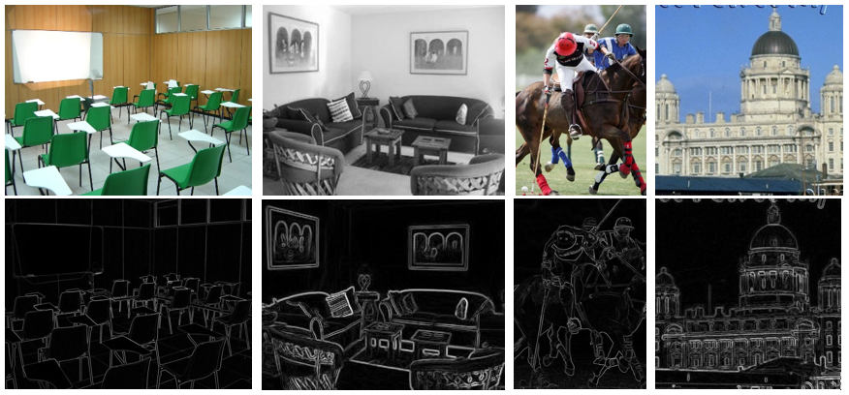
Desired Properties
Discriminating Ability
Illumination Invariance
Generalizability
Stable Code
Fig. 2: Sample images with corresponding Sobel images from different categories of object

Slide 10
Existing Works
Gradient based
Histogram of Oriented Gradient (HOG) [1]
Scale Invariant Feature Transform (SIFT) [2]
Gabor Filters [3]
LBP based
Local Binary Pattern (LBP) [4, 5]
Local Gradient Pattern (LGP) [6]
Local Ternary Pattern (LTP) [7]
Local Tetra Pattern (LTrP) [8]
Local Direction Number Pattern (LDN) [9]
Local Derivative Pattern (LDP) [10]

Slide 11
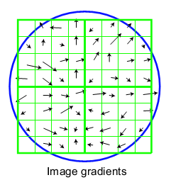
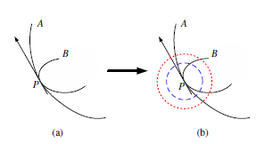
Problem Specification: gradient based techniques
Two gradients having same direction may correspond to different local structures but gradient based methods fail to differentiate those.
Fig. 3: Limitation of gradient based techniques [11]

Slide 12
Problem Specification: LBP/ CENTRIST
5 | 9 | 1
4 | 4 | 6
7 | 2 | 3
Threshold = 0
Fig. 4: Basic LBP/CENTRIST

Slide 13
Problem Specification: LBP/ CENTRIST
5 | 9 | 1
4 | 4 | 6
7 | 2 | 3
1
5 – 4 >= 0
Fig. 4: Basic LBP/CENTRIST

Slide 14
Problem Specification: LBP/ CENTRIST
5 | 9 | 1
4 | 4 | 6
7 | 2 | 3
1 | 1
9 – 4 >= 0
Fig. 4: Basic LBP/CENTRIST

Slide 15
Problem Specification: LBP/ CENTRIST
5 | 9 | 1
4 | 4 | 6
7 | 2 | 3
1 | 1 | 0
9 – 4 >= 0
Fig. 4: Basic LBP/CENTRIST

Slide 16
Problem Specification: LBP/ CENTRIST
5 | 9 | 1
4 | 4 | 6
7 | 2 | 3
1 | 1 | 0
 |  | 1
6 – 4 >= 0
Fig. 4: Basic LBP/CENTRIST

Slide 17
Problem Specification: LBP/ CENTRIST
5 | 9 | 1
4 | 4 | 6
7 | 2 | 3
1 | 1 | 0
 |  | 1
 |  | 0
3 – 4 >= 0
Fig. 4: Basic LBP/CENTRIST

Slide 18
Problem Specification: LBP/ CENTRIST
5 | 9 | 1
4 | 4 | 6
7 | 2 | 3
1 | 1 | 0
 |  | 1
 | 0 | 0
2 – 4 >= 0
Fig. 4: Basic LBP/CENTRIST

Slide 19
Problem Specification: LBP/ CENTRIST
5 | 9 | 1
4 | 4 | 6
7 | 2 | 3
1 | 1 | 0
 |  | 1
1 | 0 | 0
7 – 4 >= 0
Fig. 4: Basic LBP/CENTRIST

Slide 20
Problem Specification: LBP/ CENTRIST
5 | 9 | 1
4 | 4 | 6
7 | 2 | 3
1 | 1 | 0
1 |  | 1
1 | 0 | 0
4 – 4 >= 0
Fig. 4: Basic LBP/CENTRIST

Slide 21

Problem Specification: LBP/ CENTRIST
5 | 9 | 1
4 | 211 | 6
7 | 2 | 3
Fig. 4: Basic LBP/CENTRIST

Slide 22
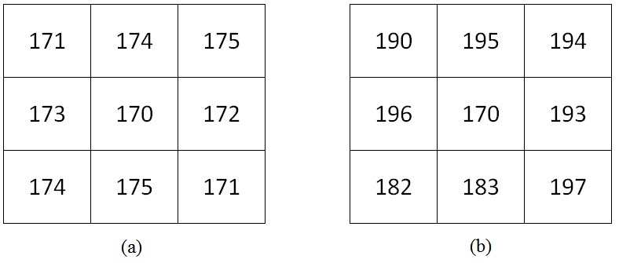


Problem Specification: LBP based techniques
Lack of discriminating ability
Fig. 5: LBP produces same pattern for (a) small and (b) large differences

Slide 23
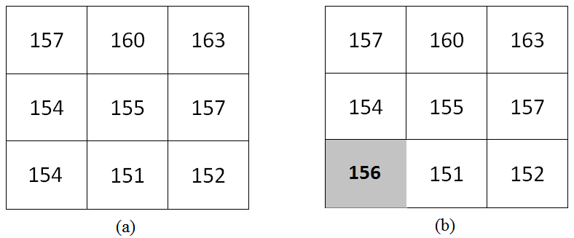


Problem Specification: LBP based techniques
Sensitive to noisy intensity fluctuation
Fig. 6: Noise sensitivity of LBP and CENTRIST (a) Original texture, (b) texture change due to intensity fluctuation

Slide 24


Solution Direction
Using other thresholds (i.e., 5) rather than zero
Fig. 7: (a) Original texture, (b) texture change due to intensity fluctuation

Slide 25
Noise Adaptive Binary Pattern (NABP)

Slide 26
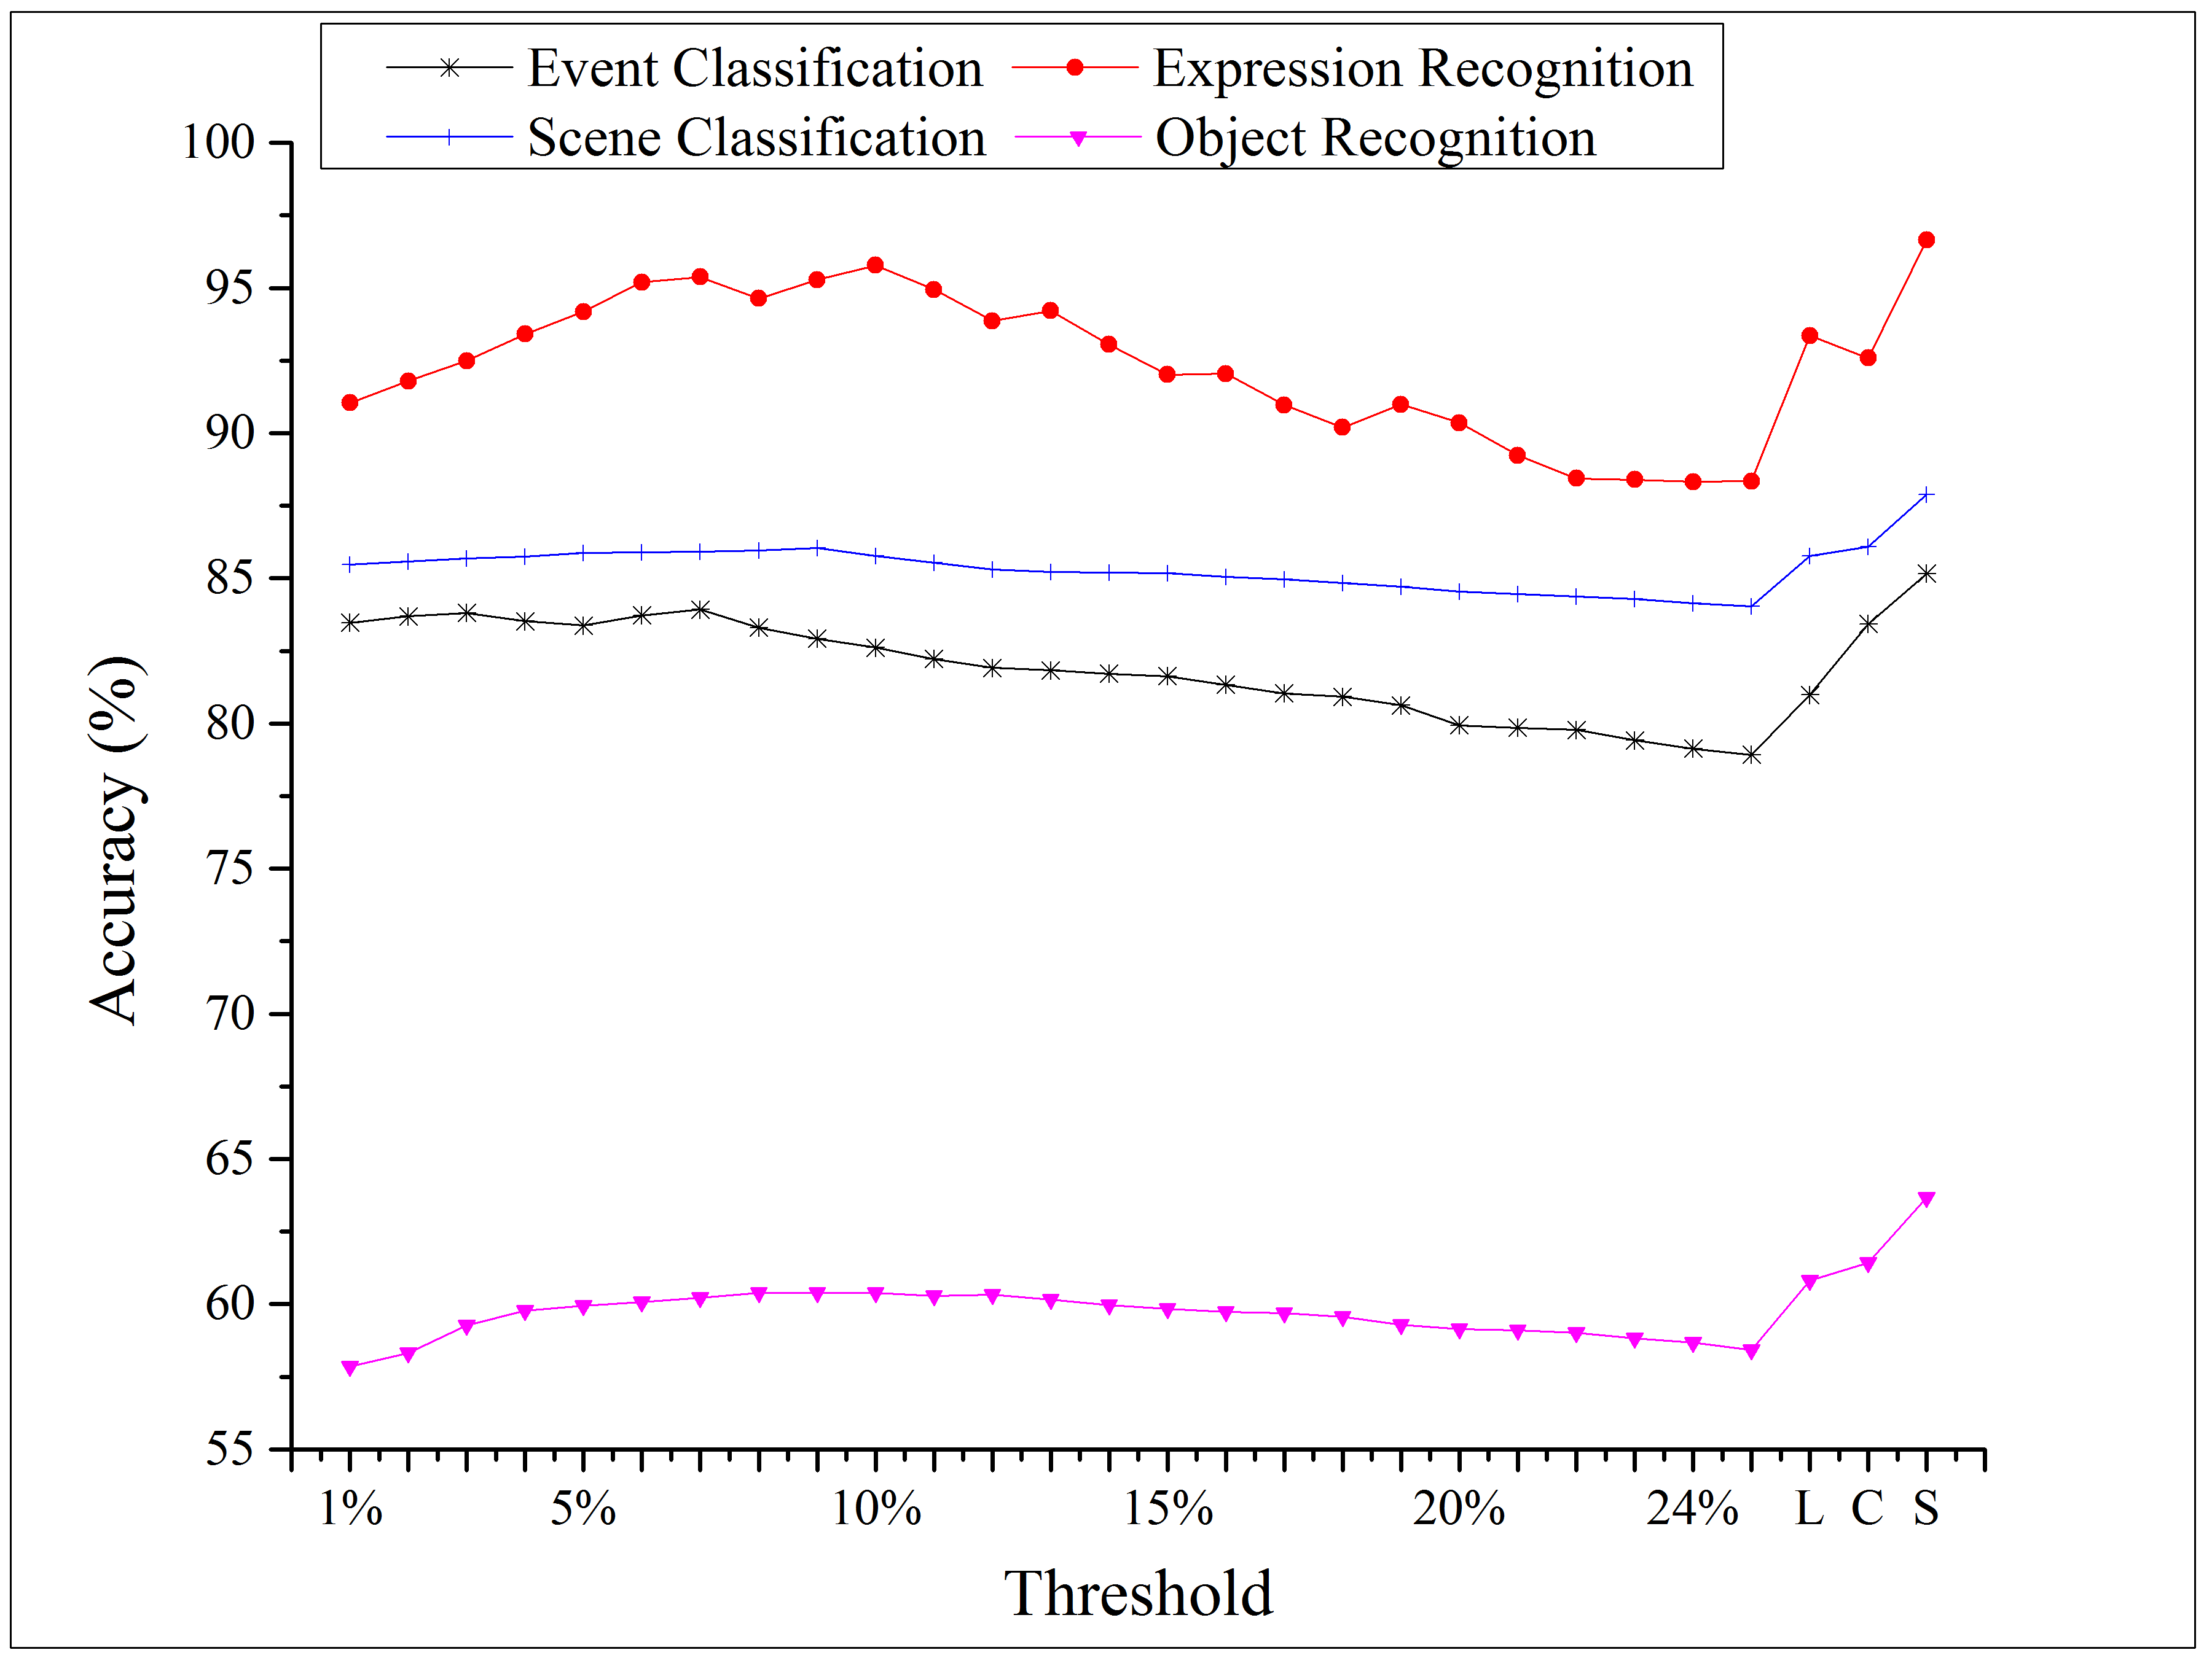
NABP: Threshold Selection
Fig. 8: Event, scene, object and expression recognition using different thresholds. L (threshold used in LGP), S (SQRT of center pixel) and C (cube root of center pixel) (Adaptive threshold)

Slide 27
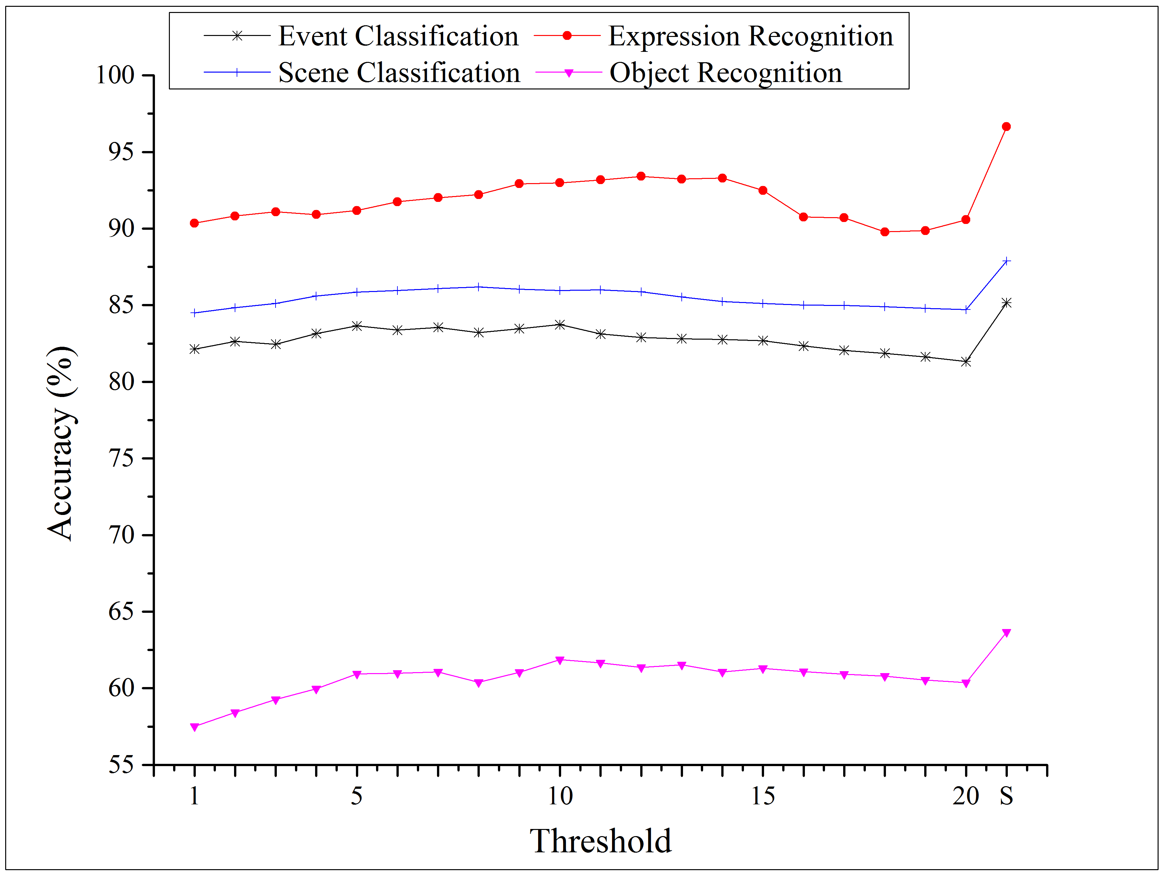
NABP: Threshold Selection
Fig. 9: Event, object, scene and expression recognition using different thresholds. Here, s is the square root of center pixel threshold. (Fixed threshold)

Slide 28
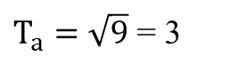
NABP
9 | 18 | 19
8 | 9 | 7
7 | 10 | 11
Fig. 10: NABP coding process where $T_{a}=\sqrt{9}=3$

Slide 29

NABP
9 | 18 | 19
8 | 9 | 7
7 | 10 | 11
0
Fig. 10: NABP coding process where $T_{a}=\sqrt{9}=3$

Slide 30
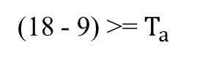
NABP
9 | 18 | 19
8 | 9 | 7
7 | 10 | 11
0 | 1
Fig. 10: NABP coding process where $T_{a}=\sqrt{9}=3$

Slide 31
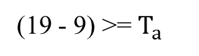
NABP
9 | 18 | 19
8 | 9 | 7
7 | 10 | 11
0 | 1 | 1
Fig. 10: NABP coding process where $T_{a}=\sqrt{9}=3$

Slide 32

NABP
9 | 18 | 19
8 | 9 | 7
7 | 10 | 11
0 | 1 | 1
 |  | 0
Fig. 10: NABP coding process where $T_{a}=\sqrt{9}=3$

Slide 33
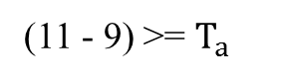
NABP
9 | 18 | 19
8 | 9 | 7
7 | 10 | 11
0 | 1 | 1
 |  | 0
 |  | 0
Fig. 10: NABP coding process where $T_{a}=\sqrt{9}=3$

Slide 34
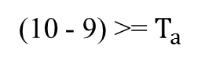
NABP
9 | 18 | 19
8 | 9 | 7
7 | 10 | 11
0 | 1 | 1
 |  | 0
 | 0 | 0
Fig. 10: NABP coding process where $T_{a}=\sqrt{9}=3$

Slide 35
NABP
9 | 18 | 19
8 | 9 | 7
7 | 10 | 11
0 | 1 | 1
 |  | 0
0 | 0 | 0
Fig. 10: NABP coding process where $T_{a}=\sqrt{9}=3$

Slide 36

NABP
9 | 18 | 19
8 | 9 | 7
7 | 10 | 11
0 | 1 | 1
0 |  | 0
0 | 0 | 0
Fig. 10: NABP coding process where $T_{a}=\sqrt{9}=3$

Slide 37

NABP
5 | 9 | 1
4 | 96 | 6
7 | 2 | 3
Fig. 10: NABP coding process where $T_{a}=\sqrt{9}=3$

Slide 38

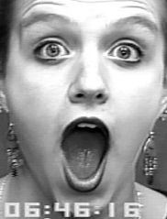
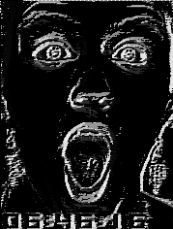
NABP
Feature Representation
Final feature is represented taking the histogram of coded image (quantized into only uniform bins)
Here, uniform bins – at most two bit-wise transition (for 8 bits images total 59 bins)
Fig. 11: NABP feature representation

Slide 39


Properties of NABP: Discriminating Ability
Fig. 12: NABP produces different patterns for (a) small and (b) large differences

Slide 40
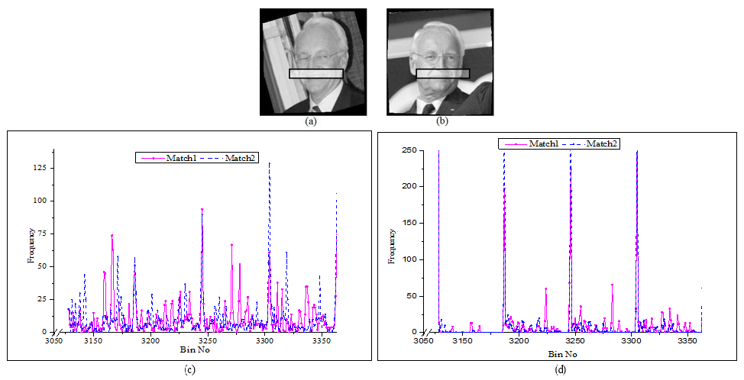
Properties of NABP: Discriminating Ability
Fig. 13: Similarity of histograms for two images of a person (a) Match image 1, (b) Match image 2, (c)-(d) LBP and NABP histogram of (a) and (b) respectively

Slide 41
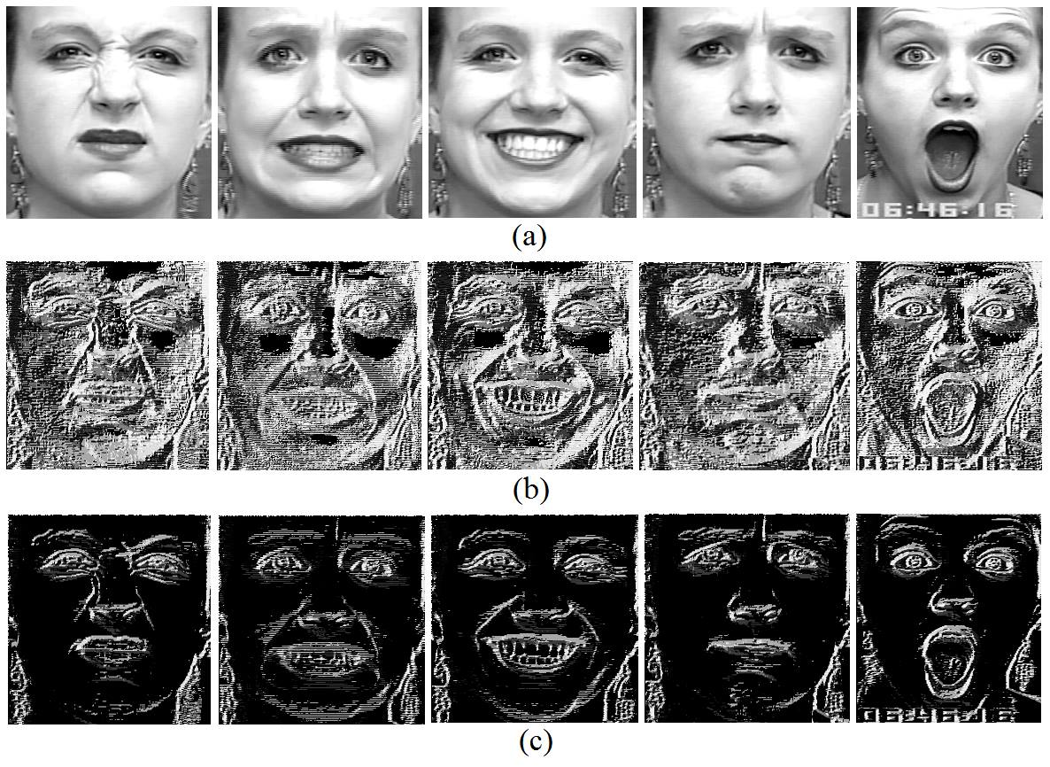
Properties of NABP: Discriminating Ability
Fig. 16: Discriminative power of different methods in expression recognition, (a) original image, (b) LBP and (c) NABP

Slide 42


Properties of NABP: Noise Adaptive
Fig. 18: Noise adaptiveness of NABP (a) original texture, (b) texture change for intensity fluctuation

Slide 43
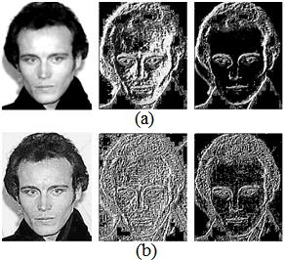
Properties of NABP: Noise Adaptive
Fig. 19: Validating noise adaptiveness of NABP (a) original texture, (b) noisy texture (left column original image, middle column LBP coded image and right column NABP coded image)

Slide 44
Limitation of NABP
NABP cannot discriminate between a positive and negative changes with the center pixel.
Only experimental justification of the threshold selection

Slide 45
Discriminating Ternary Census Transform Histogram (DTCTH)

Slide 46
DTCTH: Threshold Selection
Small threshold in small intensity and large threshold in high intensity
Capture the salient textures in both small and high intensity region
By analyzing different types of noises
Shot noise is unavoidable noise
It is dominant noise in low light condition [13]
The expected magnitude of shot noise is square root of the intensity of photon [13]

Slide 47
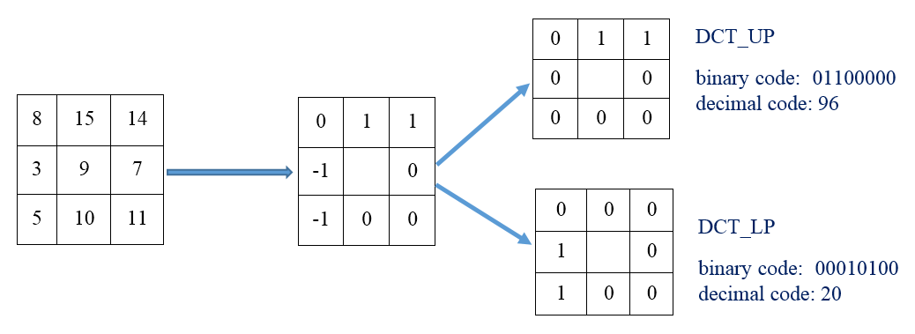
DTCTH
Fig. 20: DCT code generation

Slide 48
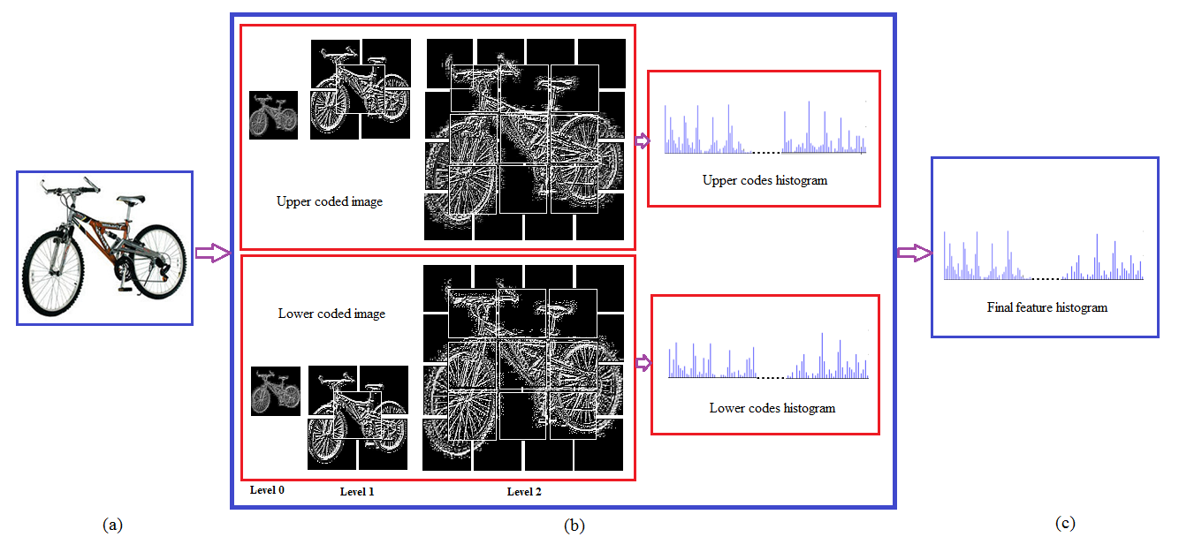
DTCTH
Fig. 21: Overall DTCTH feature generation, (a) input image, (b) spatial pyramid representation, (c) Final feature histogram

Slide 49
Properties of DTCTH
Suppress background information and capture foreground information
Produce stable code

Slide 50
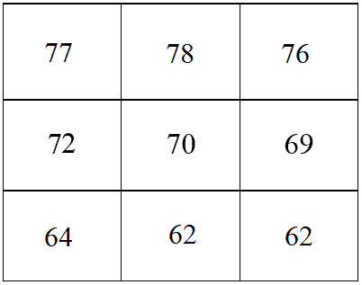
Properties of DTCTH
Discriminating ability for certain intensity changes in positive and negative directions
Three groups of codes such as uncertain state (i.e., 0 for 72 and 69),
intensity changes in positive direction (i.e., 1 for 77, 78 and 76) and
negative direction (i.e., -1 for 64, 62 and 62) in certain regions by considering 70 as the center pixel.
Fig. 24: Example of discriminating code generation

Slide 51
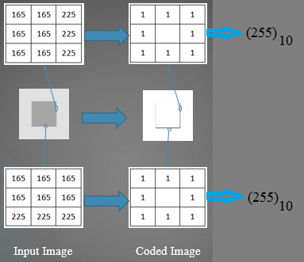
Limitation of DTCTH
DTCTH only considers sign information
Does not consider color information
Fig. 25: Lack of discriminating ability of CENTRIST and LBP based descriptors

Slide 52
Multi-channel Complementary Census Transform (MCCT)

Slide 53
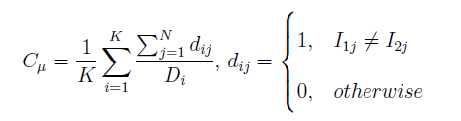

Analysis on Complementary Information
$C_{μ}$ between Sign (S) and Magnitude (M) in Different Channels
 | O1 |  | O2 |  | O3 |  | Sobel_R
 | S | M | S | M | S | M | S | M
S | 0.000 | 0.692 | 0.000 | 0.851 | 0.000 | 0.965 | 0.000 | 0.974
M | 0.692 | 0.000 | 0.851 | 0.000 | 0.965 | 0.000 | 0.974 | 0.000

Slide 54
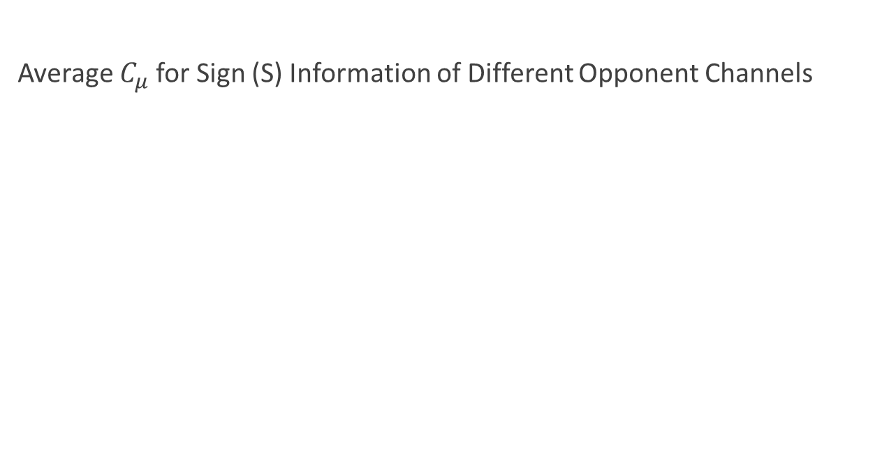
Analysis on Complementary Information
Average $C_{μ}$for Sign (S) Information of Different Opponent Channels
 | O1 | O2 | O3 | Sobel_R
O1 | 0.0000 | 0.8917 | 0.9260 | 0.9328
O2 | 0.8917 | 0.0000 | 0.8669 | 0.9190
O3 | 0.9260 | 0.8669 | 0.0000 | 0.9136
Sobel_R | 0.9328 | 0.9190 | 0.9136 | 0.0000

Slide 55
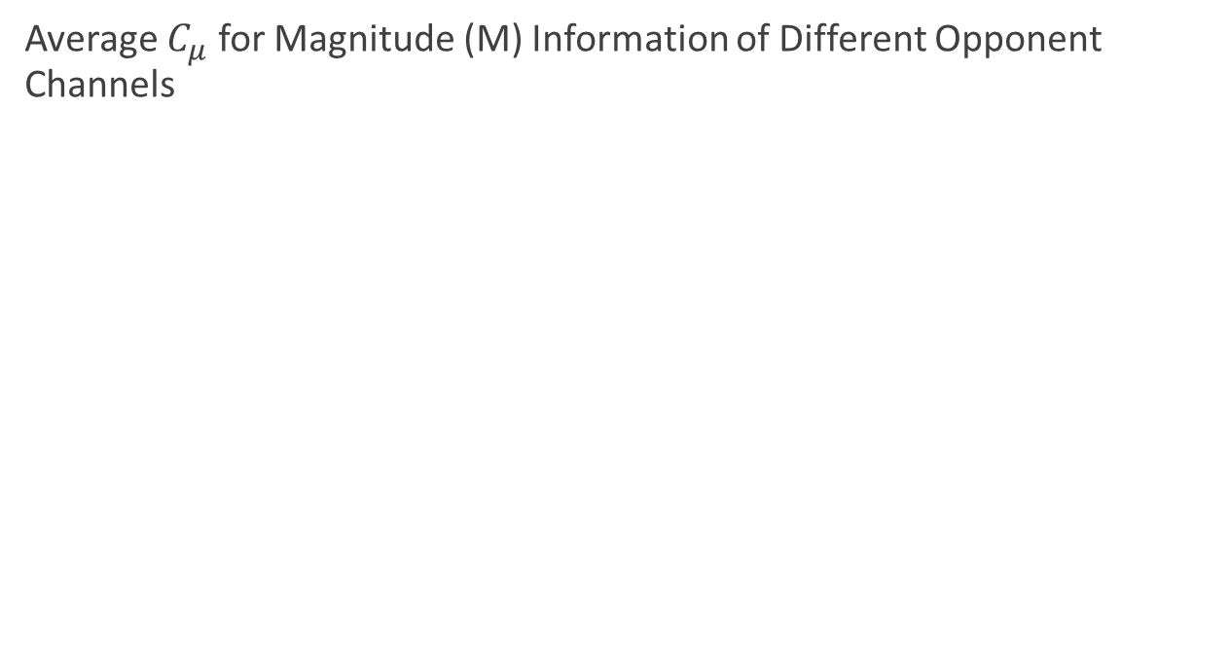
Analysis on Complementary Information
Average $C_{μ}$ for Magnitude (M) Information of Different Opponent Channels
 | O1 | O2 | O3 | Sobel_R
O1 | 0.0000 | 0.5959 | 0.6033 | 0.9031
O2 | 0.5959 | 0.0000 | 0.2963 | 0.9390
O3 | 0.6033 | 0.2963 | 0.0000 | 0.9434
Sobel_R | 0.9031 | 0.9390 | 0.9434 | 0.0000

Slide 56
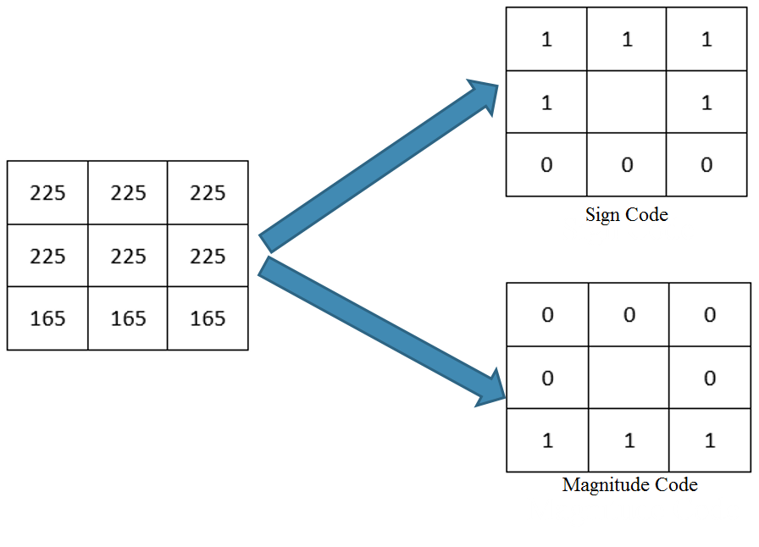
Analysis on Complementary Information
Fig. 26: An example of complementary property of sign and magnitude

Slide 57
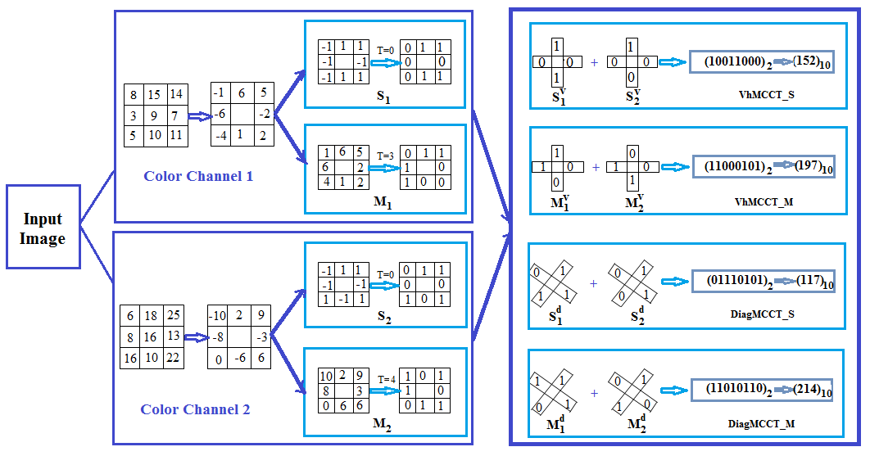
MCCT
Fig. 27: MCCT code generation process

Slide 58
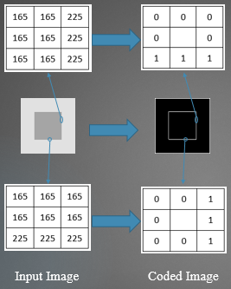
Properties of MCCT: Discriminating Ability
Fig. 28: Discriminating ability of magnitude in case of failure of sign information

Slide 59
Limitation of MCCT
Capture uncertain regions (probable to be affected by intensity fluctuation) in a single code

Slide 60
Local Quaternary Census Transform (LQCT)

Slide 61
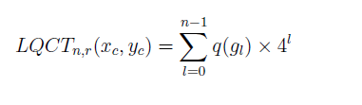
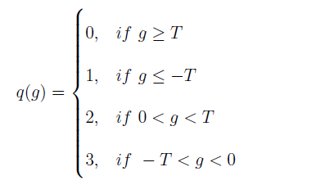
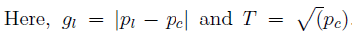
LQCT

Slide 62
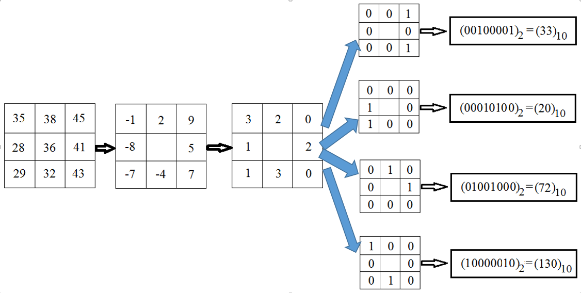
LQCT
Fig. 29: LQCT code generation process

Slide 63
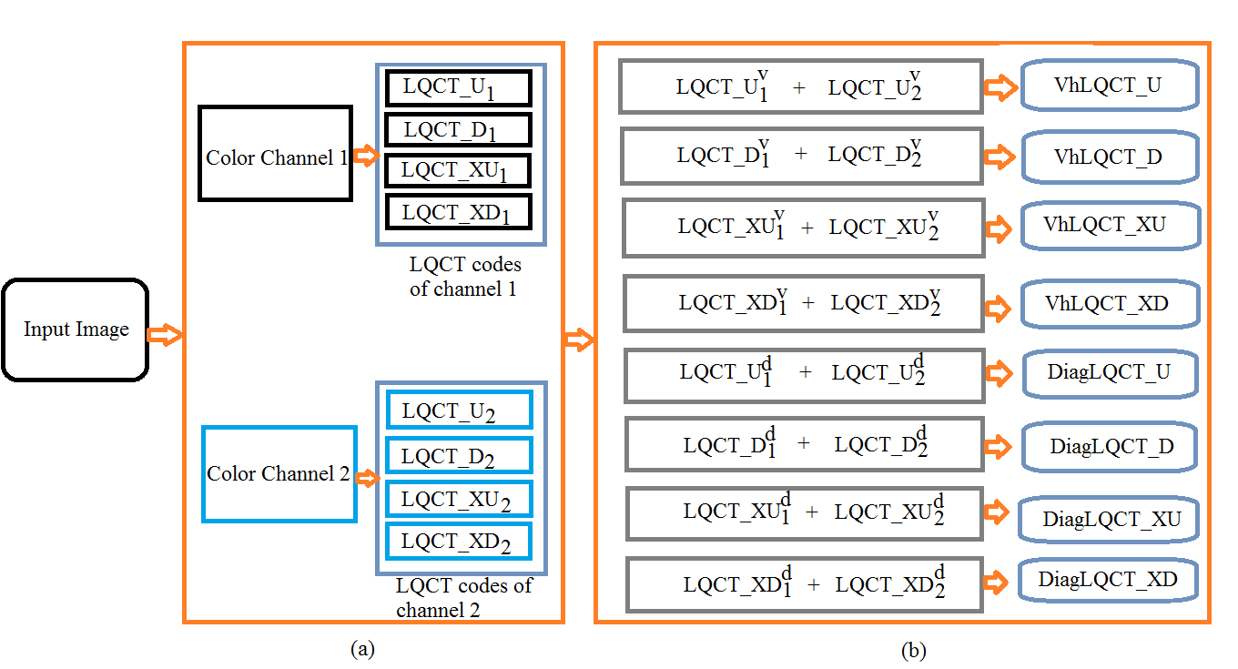
Multi-channel LQCT (mLQCT)
Fig. 30: mLQCT code generation, (a) LQCT codes from two different channels, (b) code combining process in these channels

Slide 64
Experimental Analysis

Slide 65
Implementation Details
CENTRIST and mCENTRIST frameworks
Remove the 0th and 255th bins from the histogram
Take the square root of features
Adaboost classifier for face recognition
SVM classifier with Linear and Histogram Intersection Kernels for other applications

Slide 66
Experimental Evaluation: Dataset
Applications | Datasets
Face recognition | LFW View 2
Facial expression classification | CK, CK+
Gender classification | LFW
Flower classification | Oxford Flower 102
Scene classification | MIT Indoor 67, OT scene, Scene 15, RGB-NIR scene, SUN 397
Object classification | Caltech 101, Caltech 256
Event classification | UIUC Sports Event
Aerial image classification | Land-Use 21
Leaf classification | Swedish Leaf
Garments texture classification | Fashion, Clothing Attribute
Texture classification | FMD, K’th Tips
Skin Disease classification | 3-Skin Disease

Slide 67
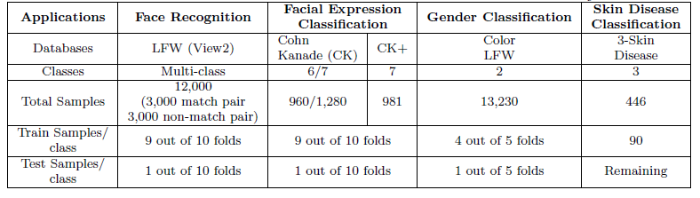
Experimental Evaluation: Dataset

Slide 68
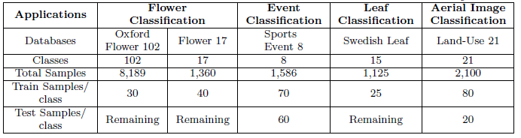
Experimental Evaluation: Dataset

Slide 69
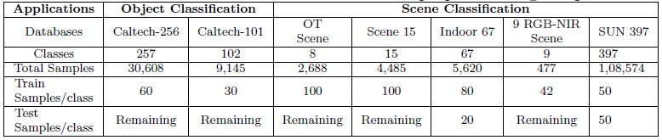
Experimental Evaluation: Dataset

Slide 70
Comparison of Computational Overhead (Avg. Computation Time)
Techniques | Average Computation Time (sec)
ScSPM | 43.95049
LLC | 45.29133
CENTRIST | 0.089131
mCENTRIST | 0.880342
LBP | 0.041313
LTP + Pyramid | 0.108612
LGP + Pyramid | 0.102825
NABP | 0.046318
DTCTH | 0.112134
MCCT | 0.927301
LQCT | 0.469733
mLQCT | 0.995431

Slide 71
Face Recognition: LFW View2
Features | Accuracy (%)
 | Original | Aligned
LBP | 67.92 | 69.90
LTP | 68.62 | 72.06
LGP | 63.83 | 67.57
HOG | 67.32 | 69.23
Gabor [3] | 62.93 | -
LDN [10] | 69.08 | -
NABP (Proposed) | 72.58 | 74.81

Slide 72
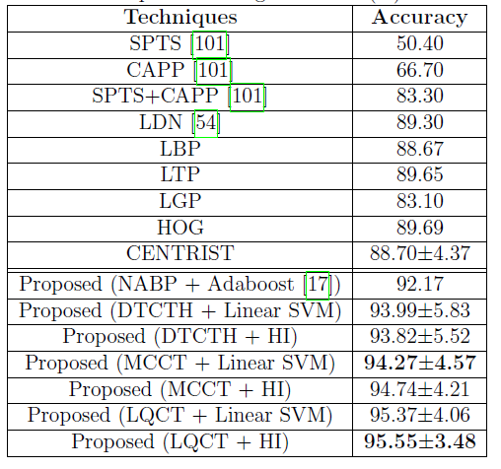
Expression Recognition: CK+

Slide 73
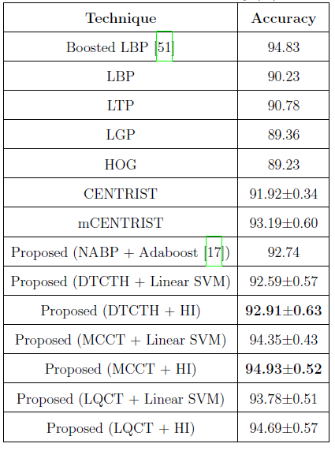
Gender Classification: LFW

Slide 74
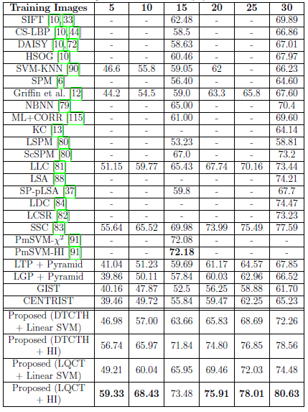
Object Classification: Caltech 101

Slide 75
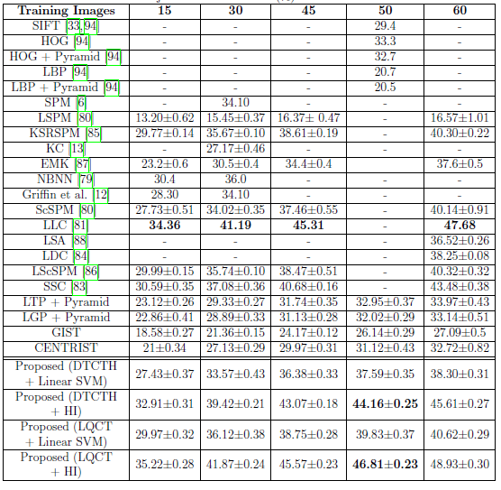
Object Classification: Caltech 256

Slide 76
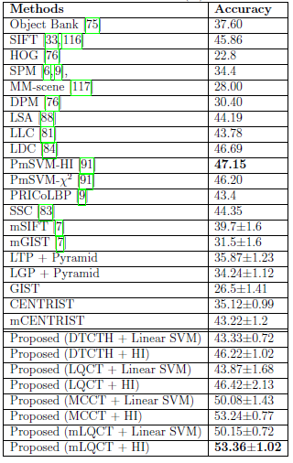
Scene Classification: Indoor 67

Slide 77
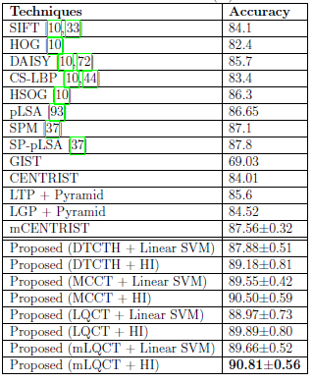
Scene Classification: OT Scene

Slide 78
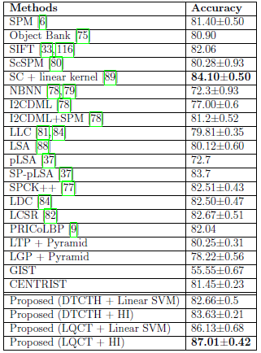
Scene Classification: Scene 15

Slide 79
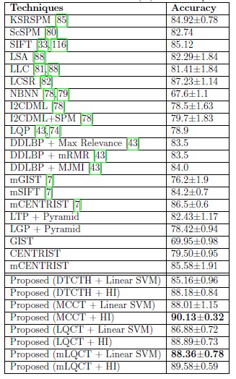
Event Classification: UIUC Sports Event

Slide 80
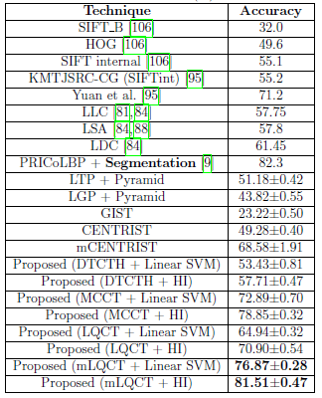
Flower Classification: Oxford Flower 102

Slide 81
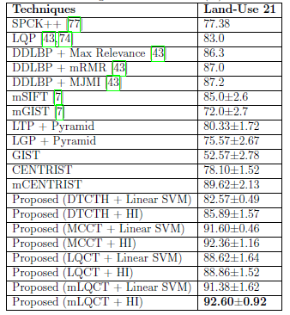
Aerial Image Classification: Land-Use 21

Slide 82
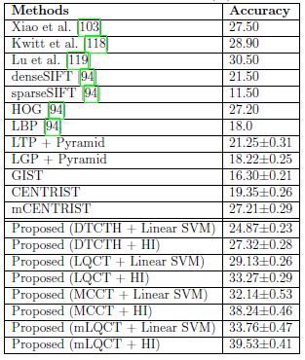
Scene Classification: SUN 397

Slide 83
Conclusion and Future Work
Conclusion
MCCT performs well in color image classification
LQCT performs well in gray-scale image while its extension mLQCT performs well in color image classification
mLQCT > LQCT > MCCT > DTCTH > NABP (with respect to response time)
Future Work
High level representation will be incorporated with all the proposed descriptors
Sparse coding
Pooling techniques

Slide 84
Publications
1. “Noise adaptive binary pattern for face image analysis," in Computer and Information Technology (ICCIT), 2015 18th International Conference on. IEEE, 2015. The contribution of chapter 5. (1st prize, best paper award, 18th ICCIT, 2015)
2. “DTCTH: A Discriminative Local Pattern Descriptor for Image Classification,“ Eurasip Journal of Image and Video Processing, March, 2016. The contribution of chapter 6. (Submitted)
3. “MCCT: A Multi-channel Complementary Census Transform for Image Classification," Journal of Signal, Image and Video Processing, April, 2016. The contribution of chapter 7. (Submitted)

Slide 85
References
[1] Déniz, Oscar, Gloria Bueno, Jesús Salido, and Fernando De la Torre. "Face recognition using histograms of oriented gradients." Pattern Recognition Letters 32, no. 12 (2011): 1598-1603.
[2] Lowe, David G. "Object recognition from local scale-invariant features." In Computer vision, 1999. The proceedings of the seventh IEEE international conference on, vol. 2, pp. 1150-1157. IEEE, 1999.
[3] Yang, Meng, Lei Zhang, Simon CK Shiu, and David Zhang. "Gabor feature based robust representation and classification for face recognition with Gabor occlusion dictionary." Pattern Recognition 46, no. 7 (2013): 1865-1878.
[4] Ojala, Timo, Matti Pietikäinen, and Topi Mäenpää. "Multiresolution gray-scale and rotation invariant texture classification with local binary patterns." Pattern Analysis and Machine Intelligence, IEEE Transactions on 24, no. 7 (2002): 971-987.
[5] Ahonen, Timo, Abdenour Hadid, and Matti Pietikainen. "Face description with local binary patterns: Application to face recognition." Pattern Analysis and Machine Intelligence, IEEE Transactions on 28, no. 12 (2006): 2037-2041.
[6] Jun, Bongjin, Inho Choi, and Daijin Kim. "Local transform features and hybridization for accurate face and human detection." Pattern Analysis and Machine Intelligence, IEEE Transactions on 35, no. 6 (2013): 1423-1436.
[7] Tan, Xiaoyang, and Bill Triggs. "Enhanced local texture feature sets for face recognition under difficult lighting conditions." Image Processing, IEEE Transactions on 19, no. 6 (2010): 1635-1650.

Slide 86
References
[8] Murala, Subrahmanyam, R. P. Maheshwari, and R. Balasubramanian. "Local tetra patterns: a new feature descriptor for content-based image retrieval." Image Processing, IEEE Transactions on 21, no. 5 (2012): 2874-2886.
[9] Ramirez Rivera, Adin, Jorge Rojas Castillo, and Oksam Chae. "Local directional number pattern for face analysis: Face and expression recognition." Image Processing, IEEE Transactions on 22, no. 5 (2013): 1740-1752.
[10] Zhang, Baochang, Yongsheng Gao, Sanqiang Zhao, and Jianzhuang Liu. "Local derivative pattern versus local binary pattern: face recognition with high-order local pattern descriptor." Image Processing, IEEE Transactions on 19, no. 2 (2010): 533-544.
[11] Mu, Yadong, Shuicheng Yan, Yi Liu, Thomas Huang, and Bingfeng Zhou. "Discriminative local binary patterns for human detection in personal album." In Computer Vision and Pattern Recognition, 2008. CVPR 2008. IEEE Conference on, pp. 1-8. IEEE, 2008.
[12] Lucey, Patrick, Jeffrey F. Cohn, Takeo Kanade, Jason Saragih, Zara Ambadar, and Iain Matthews. "The Extended Cohn-Kanade Dataset (CK+): A complete dataset for action unit and emotion-specified expression." In Computer Vision and Pattern Recognition Workshops (CVPRW), 2010 IEEE Computer Society Conference on, pp. 94-101. IEEE, 2010.
[13] Markus Greiner, CA Regal, JT Stewart, and DS Jin. Probing pair-correlated fermionic atoms through correlations in atom shot noise. Physical review letters, 94(11):110401, 2005.

Slide 87
Any Question?

Slide 88
Thank You

Slide 89
Appendix

Slide 90
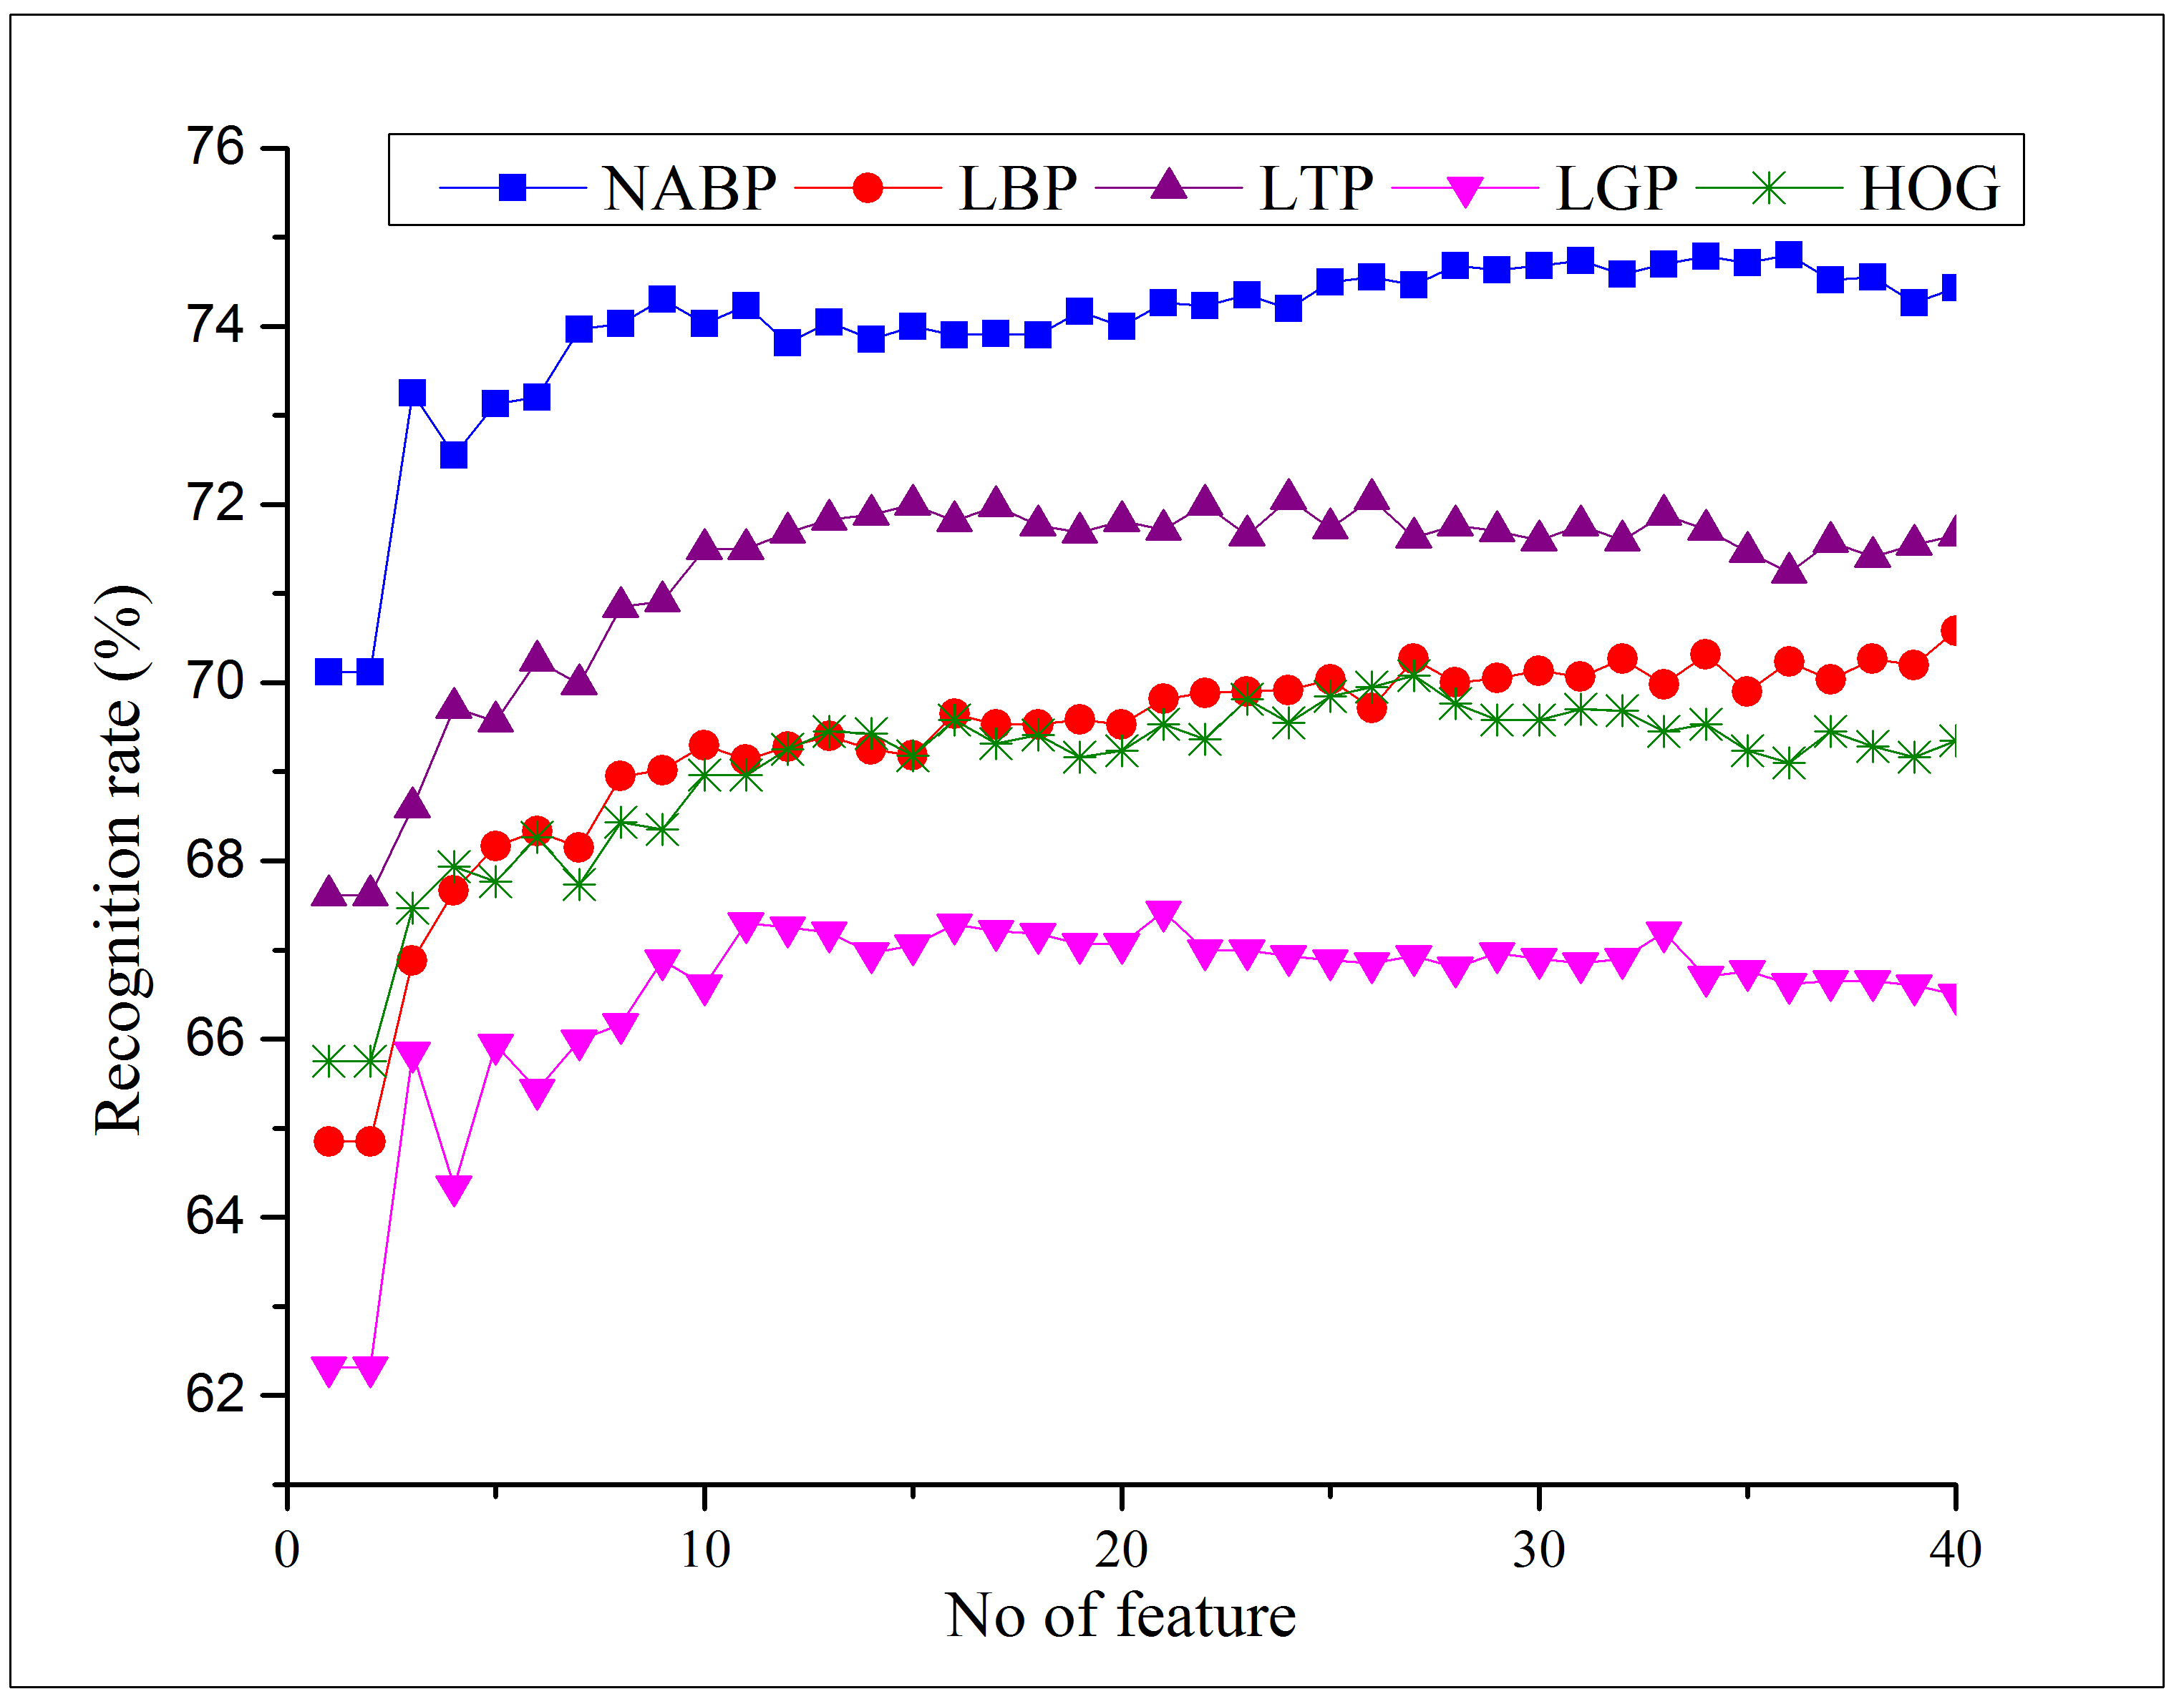
Face Recognition
Fig. 6: NABP feature coding procedure where Ta=3
Fig. 36: Face recognition results in LFW

Slide 91
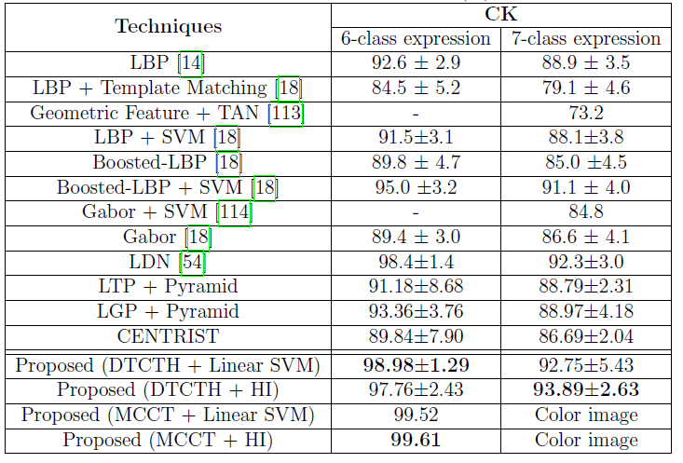
Expression Recognition: CK

Slide 92
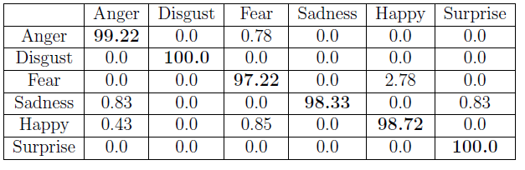
Expression Recognition: CK
Table II: Confusion matrix of DTCTH for 6 class expression recognition rate in CK

Slide 93

Expression Recognition: CK
Table II: Confusion matrix of DTCTH for 7 class expression recognition rate in CK

Slide 94

Expression Recognition: CK+
Table II: Confusion matrix of DTCTH for 7 class expression recognition rate in CK+

Slide 95

Leaf Classification: Swedish Leaf

Slide 96

Scene Classification: RGB NIR Scene 9

Slide 97

Garments Texture Classification: Fashion

Slide 98

Garments Texture Classification: Clothing Attribute

Slide 99

Texture Classification: FMD

Slide 100

Texture Classification: K’th Tips

Slide 101

Skin Disease Classification: 3-Skin Disease

